Slide 1
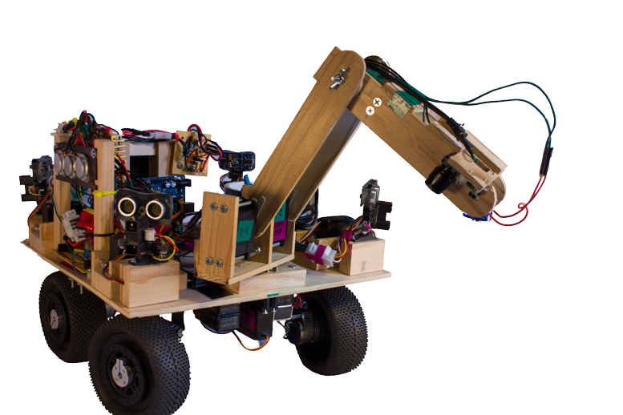
Autonomous Soil Investigator
Notes:
INTRO

Slide 2
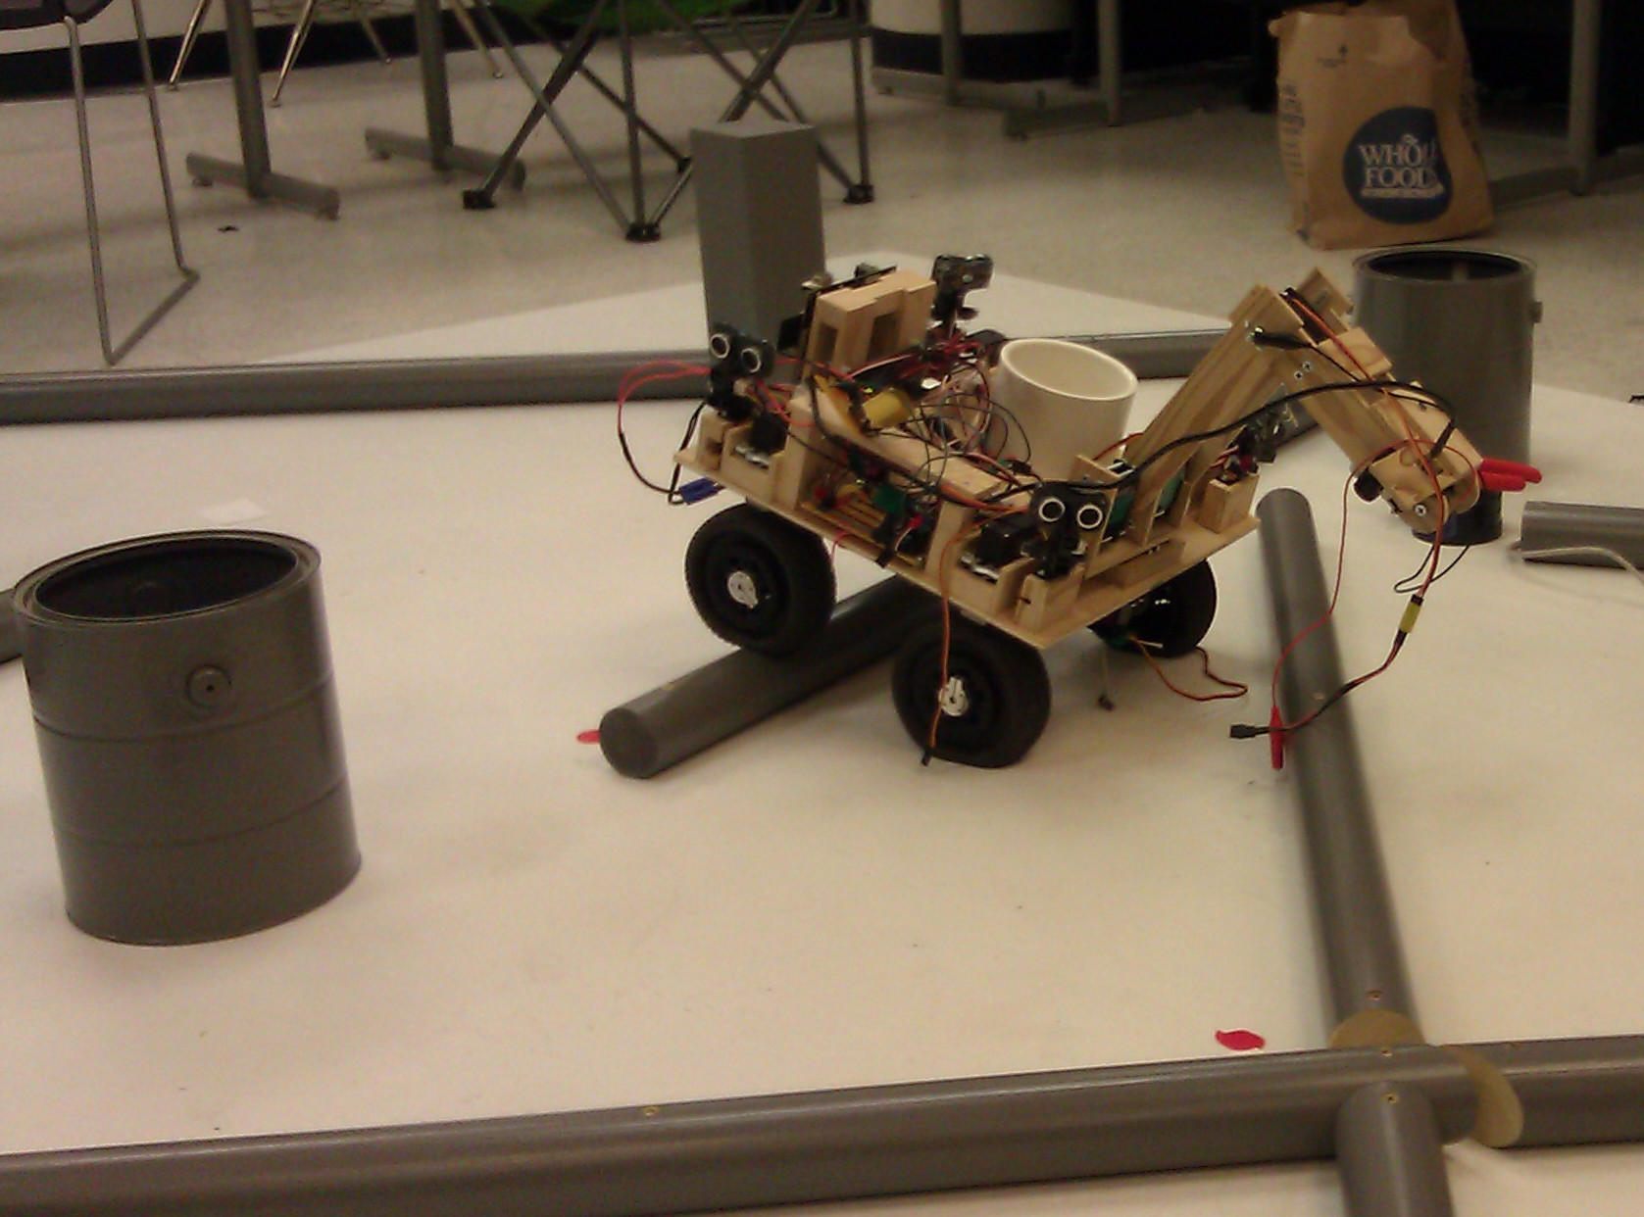
What Is the ASI?
2013 IEEE student robotics challenge
Notes:
INTRO

Slide 3
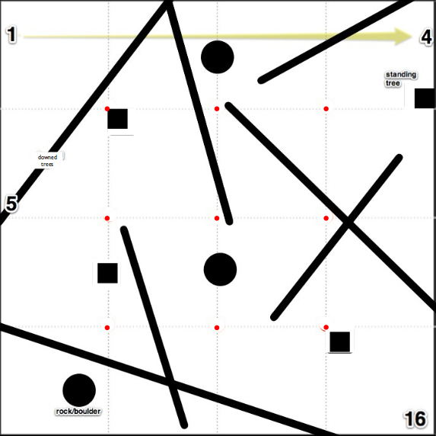
The Challenge:
Collect 6 Pucks
Restrictions
Size
Weight
Time limit
Cost
Obstacles
Scale
Avoid

Slide 4
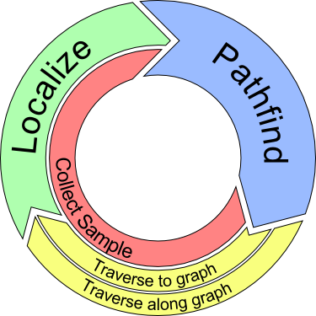
The ASI Solution
Localization
Where am I?
Traversal
Where do I go?
How do I get there?
Collection
Pick up an object
Notes:
INTRO

Slide 5
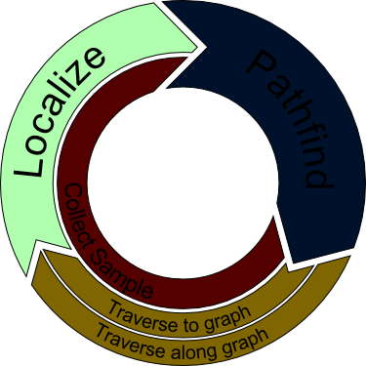
Localization
Position and Orientation Awareness

Slide 6
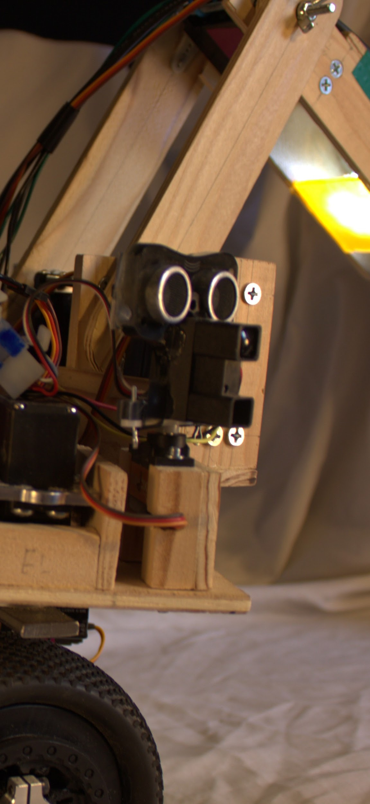
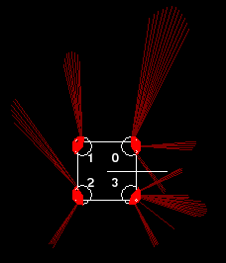
Localization sensors:
Four eye modules, each with
Infrared rangefinder
Ultrasonic rangefinder
Sweeping Servo Motor

Slide 7
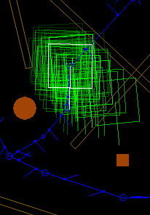
Localization procedure
Make a cloud of position hypotheses (hypobots)
Simulate expected measurements for each hypobot
Compare simulations to real measurements
Weight each hypobot
Notes:
LOCALIZATION
Particle Filter:
-uses a cloud of discrete hypotheses (Hypobots) of the robot's position
-Cloud mimics robot's intended motions
-Each time a measurement is performed, each hypothesis is weighted

Slide 8
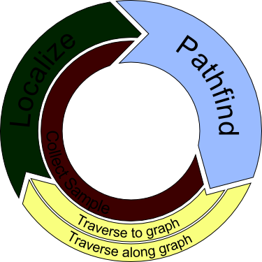
Pathfinder
Planning and Routing
New Data:
Localization
IMU
Pucks
Static Data:
Graph

Slide 9
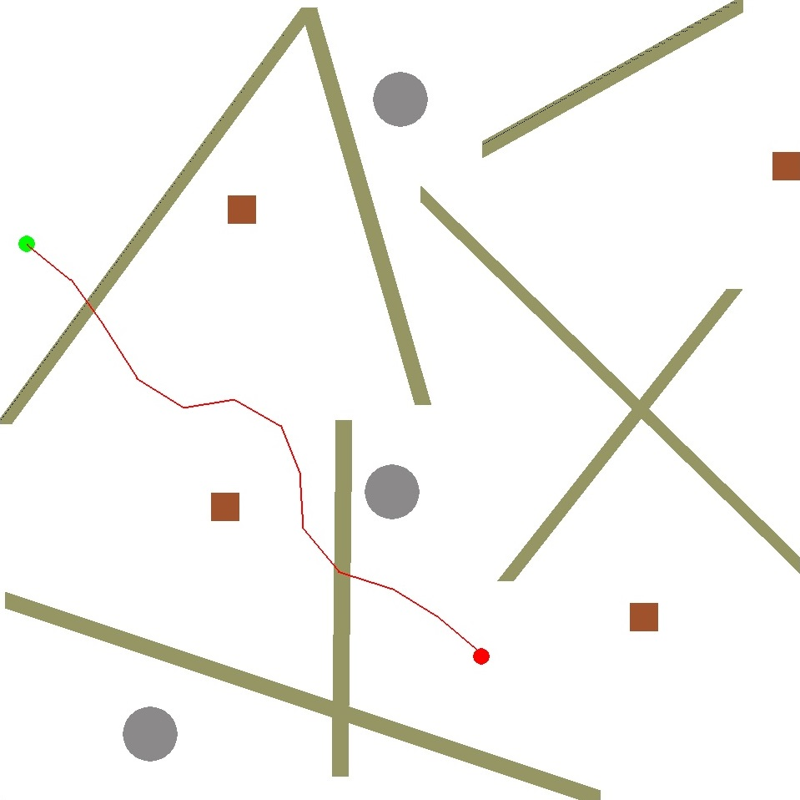
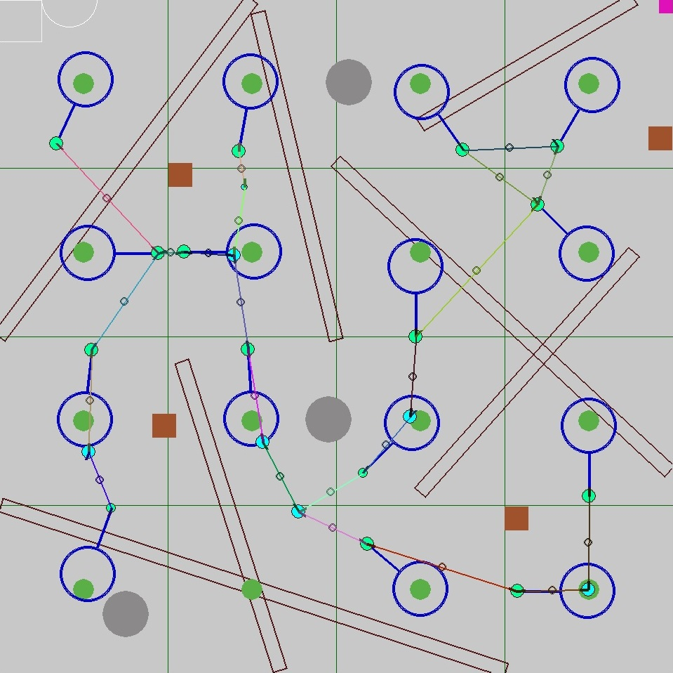
Pathfinders
Probabilistic
Pathfinding
Planned Pathing
vs.
Notes:
Statistical pathfinder is slow while trying to navigate in two dimensions while avoiding objects and crossing logs at 90 degrees, and is under equipped at finding "tricky" solutions. Route mapping by hand made sense since we have a known terrain, and it makes the traveling salesman problem tractable.

Slide 10
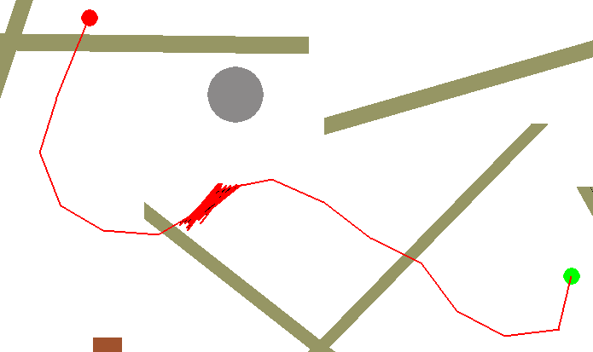
Probabilistic pathfinding
3D pathfinding
X, Y, Theta
No trick solutions
Potential wells
Unsafe paths

Slide 11
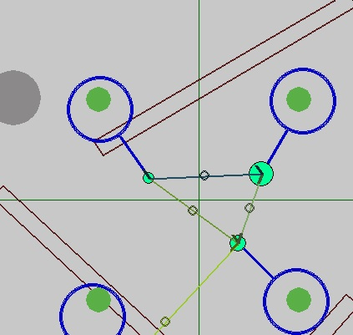
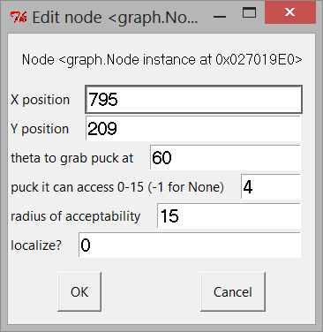
Planned Pathing
Location specific conditions
Custom User Interface
Optimal solutions
Trick solutions

Slide 12
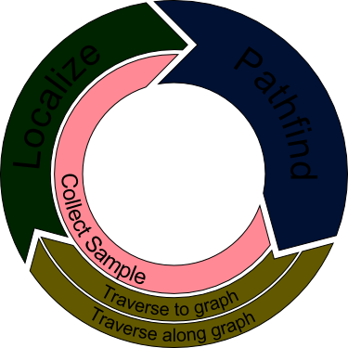
Collection
Target Acquisition

Slide 13
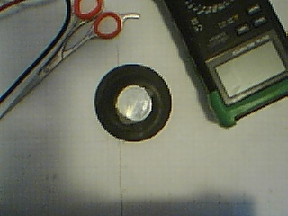
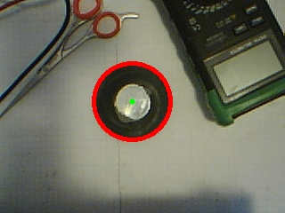
OpenCV - Computer Vision tool library
Used to precisely locate samples

Slide 14
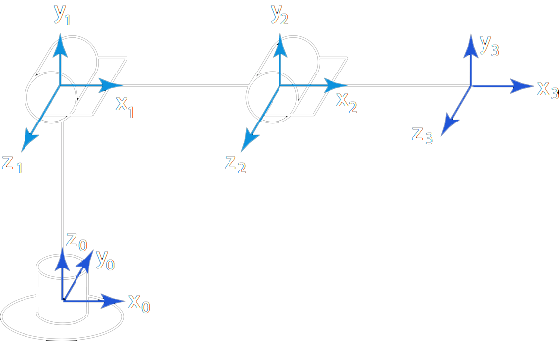
Robotic Arm
Inverse Kinematics

Slide 15
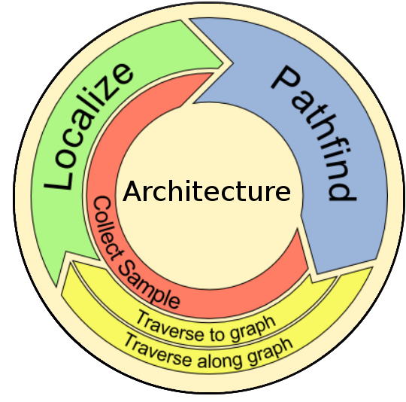
Hardware & Software
Control System

Slide 16
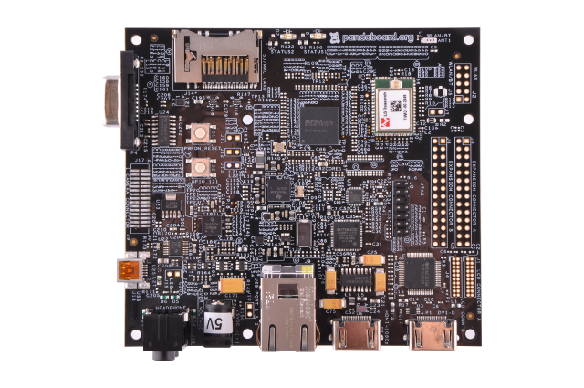

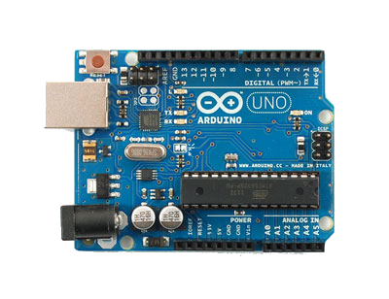
Hardware
Panda Board
The Brain
High Level Computing
Dual Core, 1.2 GHz
Python Language
Microcontroller
The Nervous System
Motors & Sensors
28 Mhz
C++ Language

Slide 17
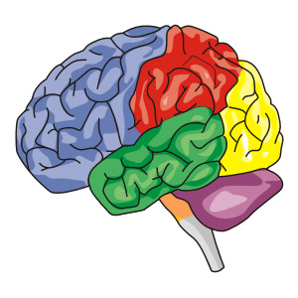
Software
MODES
Dynamic Modes
Messenger
Classes
Controls and
Sensors
Messenger
Messenger
Controls & Sensors
Notes:
Each operation the robot performs is a mode.
For example, Localization, Collection, and Traversal are modes.
The architecture binds the modes in the source code into a central logical unit called the base.
The messenger provides an API for sending and receiving messages.
Messages are encoded and sent to the Arduino.
The Arduino decodes the messages and takes action.

Slide 18
Methodology
Polymorphism
Tailored Behaviors
Modular Design
Init
Localize
Pathfinding
Collect
?
Abstract Mode
Notes:
The modes use polymorphism to tailor the behavior of the base.
A mode continues operation until its objectives have been completed.
Each mode transitions to the next mode.

Slide 19
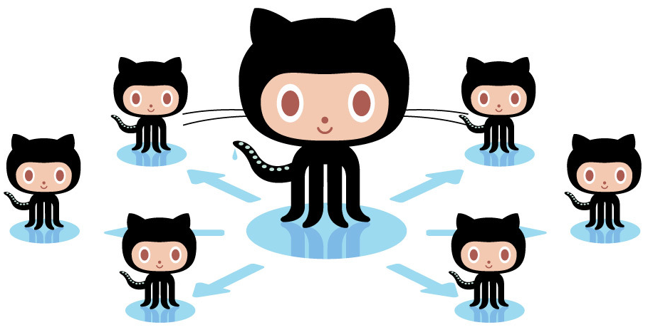
Collaboration
Github (group coding software)
Distributed workflow
Quality
Recovery
Notes:
Github allows our team to work remotely.
Quality is assured while merging source code.
Any previous version can be recovered.

Slide 20
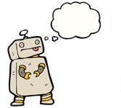
Lessons Learned
Consider the robot's needs, not your own
Don't buy any part without a datasheet
Modular design pays off
Robustness over speed

Slide 21
